Slide 1


Computer Concepts 2018
Module 9
Information Systems
© 2019 Cengage. All rights reserved.

Slide 2
Module Contents
Section A: Information System Basics
Section B: Enterprise Applications
Section C: Systems Analysis
Section D: Design and Implementation
Section E: System Security

Slide 3
Section A: Information Basics
Enterprise Basics
Transaction Processing Systems
Management Information Systems
Decision Support Systems
Expert Systems

Slide 4
Section A: Objectives (1 of 2)
Explain the relationship between an organization, its mission, and its information system
Provide examples of vertical and horizontal market applications
Match strategic, tactical, and operational planning needs to employees at each level of an organizational chart

Slide 5
Section A: Objectives (2 of 2)
Describe three classifications of problems
Describe the characteristics of TPS, MIS, DSS, and expert systems
Use the terms decision model and decision query in a sentence
Explain how fuzzy logic is used by expert systems

Slide 6
Enterprise Basics (1 of 6)
An information system collects, stores, and processes data to provide useful, accurate, and timely information, typically within the context of an organization
An organization is a group of people working together to accomplish a goal
Any organization that seeks profit by providing goods and services is called a business or an enterprise
An organization’s goal or plan is referred to as its mission; its mission statement describes not only an organization’s goals, but also the way in which those goals will be accomplished

Slide 7
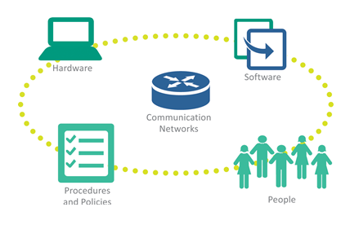
Enterprise Basics (2 of 6)

Slide 8
Enterprise Basics (3 of 6)
Vertical market software is designed for a specific industry or enterprise; the software that controls touchscreen order entry at fast-food restaurants is an example of software designed for vertical markets
Horizontal market software is designed for common elements of many businesses

Slide 9
Enterprise Basics (4 of 6)
An organizational chart depicts the hierarchy of employees in an organization
Workers are the people who directly carry out the organization’s mission
Managers determine organizational goals and plan how to achieve those goals; managers use the following methods:
Strategic planning – emphasis on long-range and future goals
Tactical planning – setting incremental goals that can be achieved in a year or less
Operational planning – covers activities that make day-to-day operations run smoothly

Slide 10
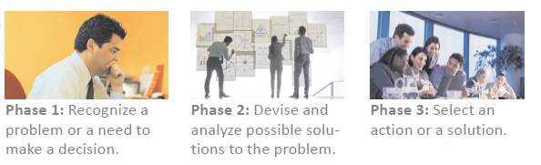
Enterprise Basics (5 of 6)

Slide 11
Enterprise Basics (6 of 6)
All can be classified into three types: structured, semi-structured, and unstructured
TYPE OF PROBLEM | EXAMPLES | METHODOLOGY
A structured problem is an everyday, run-of-the-mill, routine problem. When you make decisions in response to structured problems, the procedure for obtaining the best solution is known, the objective is clearly defined, and the information necessary to make the decision is easy to identify. | Which customers should receive over-due notices? | The information for this decision is usually stored in a file cabinet or computer system. The method for reaching a solution is to look for customers with outstanding balances, and then check whether the due dates for their payments fall before today’s date.
A semi-structured problem has a known procedure for arriving at a solution; however, the process might involve some degree of subjective judgment. Also, some of the information regarding the problem might not be available, might lack precision, or might be uncertain. | How many mountain bikes should a store stock for the holidays? | The decision can be based on the previous year’s sales; but because future consumer spending is uncertain, determining the appropriate amount of holiday inventory might require some guesswork.
An unstructured problem requires human intuition as the basis for finding a solution. Information relevant to the problem might be missing, and few parts of the solution can be tackled using concrete models. If experts are presented with a problem but they disagree on a solution, it is likely an unstructured problem. | Should Saks Fifth Avenue stock Japanese-inspired evening gowns? | The purchasing agent for women’s clothing makes this decision based on her intuition of customer taste and fashion trends.

Slide 12
Transaction Processing Systems (1 of 2)
In an information system context, a transaction is an exchange between two parties that is recorded and stored in a computer system
A transaction processing system (TPS) provides a way to collect, process, store, display, modify, or cancel transactions
Transaction processing systems, such as banking, use online processing—a real-time method in which each transaction is processed as it is entered; this system software is often referred to as an OLTP (online transaction processing) system
Detail reports provide a basic record of complete transactions

Slide 13
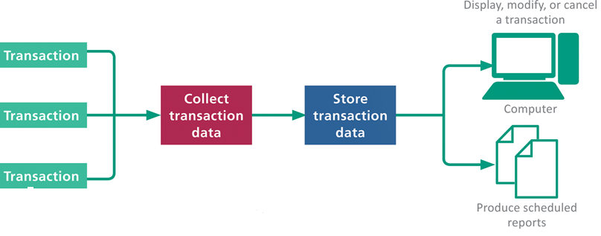
Transaction Processing Systems (2 of 2)
A transaction processing system is characterized by its ability to:
Collect, display, and modify transactions
Store transactions
List transactions

Slide 14
Management Information Systems (1 of 2)
The term management information system refers to any computer system that processes data and provides information within a business setting
Managers depend on these reports to make routine business decisions
A summary report combines, groups, or totals data
An exception report contains information that is outside of normal or acceptable ranges

Slide 15
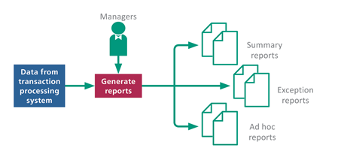
Management Information Systems (2 of 2)
A management information system is characterized by its ability to:
Produce routine and on-demand reports
Provide useful information for managerial activities
Increase managerial efficiency
Provide information used for structured, routine decisions

Slide 16
Decision Support Systems (1 of 3)
A decision support system (DSS) helps people make decisions by directly manipulating data, accessing data from external sources, generating statistical projections, and creating data models of various scenarios
An executive information system (EIS) is a type of decision support system designed to provide senior managers with information relevant to strategic management activities

Slide 17
Decision Support Systems (2 of 3)
A decision model is a numerical representation of a realistic situation, such as a cash-flow model of a business that shows how income adds to cash accounts
A decision query is a question or a set of instructions describing data that must be gathered to make a decision

Slide 18
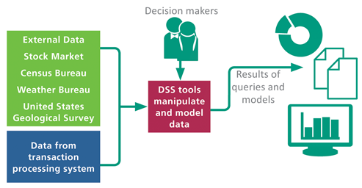
Decision Support Systems (3 of 3)

Slide 19
Expert Systems (1 of 4)
An expert system, sometimes referred to as a knowledge-based system, is a computer system designed to analyze data and produce a recommendation, diagnosis, or decision based on a set of facts and rules
The facts and rules are incorporated into a knowledge base that is stored in a computer file and can be manipulated by software called an inference engine
The process of designing, entering, and testing the rules in an expert system is referred to as knowledge engineering

Slide 20
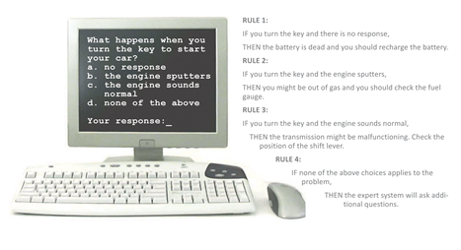
Expert Systems (2 of 4)

Slide 21
Expert Systems (3 of 4)
An expert system shell is a software tool containing an inference engine and a user interface that developers use to enter facts and rules for a knowledge base
These systems are designed to deal with data that is imprecise or problematic; using a technique called fuzzy logic, an expert system can deal with this type of data by working with confidence levels

Slide 22
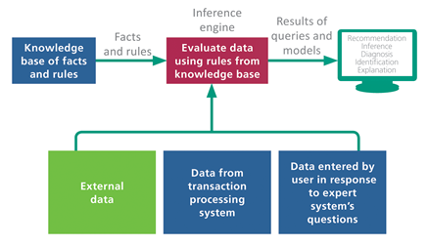
Expert Systems (4 of 4)

Slide 23
Section B: Enterprise Applications
Ecommerce
Supply Chain Management
Customer Relationship Management
Enterprise Resource Planning

Slide 24
Section B: Objectives
Provide at least two examples of businesses that engage in each of the following types of ecommerce: B2C, B2B, C2C, and B2G
List the cookie-related events that occur during an online shopping session
Explain how just-in-time inventory is related to SCM
Draw a diagram of a supply chain
Describe how loyalty programs are related to CRM
List the six major components of an ERP application
List at least five benefits of ERP systems

Slide 25
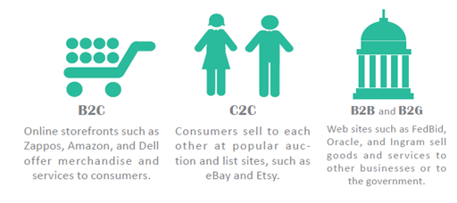
Ecommerce (1 of 3)
Ecommerce refers to business transactions that are conducted electronically over a computer network

Slide 26
Ecommerce (2 of 3)
An ecommerce application is the software that handles ecommerce transactions
Payment processing is based on an online payment gateway that authorizes credit and debit cards, PayPal, and Apple Pay transactions

Slide 27
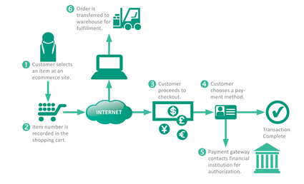
Ecommerce (3 of 3)

Slide 28
Supply Chain Management
A supply chain is the sequence of organizations, people, activities, information, and resources involved in moving a product or service from supplier to customer
Supply chains are complex, so businesses use SCM (supply chain management) to maximize efficiency and profitability

Slide 29
Customer Relationship Management (1 of 2)
The acronym CRM stands for customer relationship management and refers to practices and technologies that companies use to analyze and improve interactions with customers
A major source of data for CRM is produced by loyalty programs, or a rewards program, which are marketing efforts that provide customers with incentives for making purchases

Slide 30
Customer Relationship Management (2 of 2)
Customer Facing
Enhance the ecommerce site with search, recommendations, and reviews.
Collect customer email addresses from loyalty programs and build profiles in a database.
Target customers in the database with email marketing.
Provide customer service through online chat and easy returns.
Promote products in blogs and social media ads.
Back Office
Provide analytics for back-office demand fore-casting and online metrics, such as the number of visitors, mentions, and likes.

Slide 31
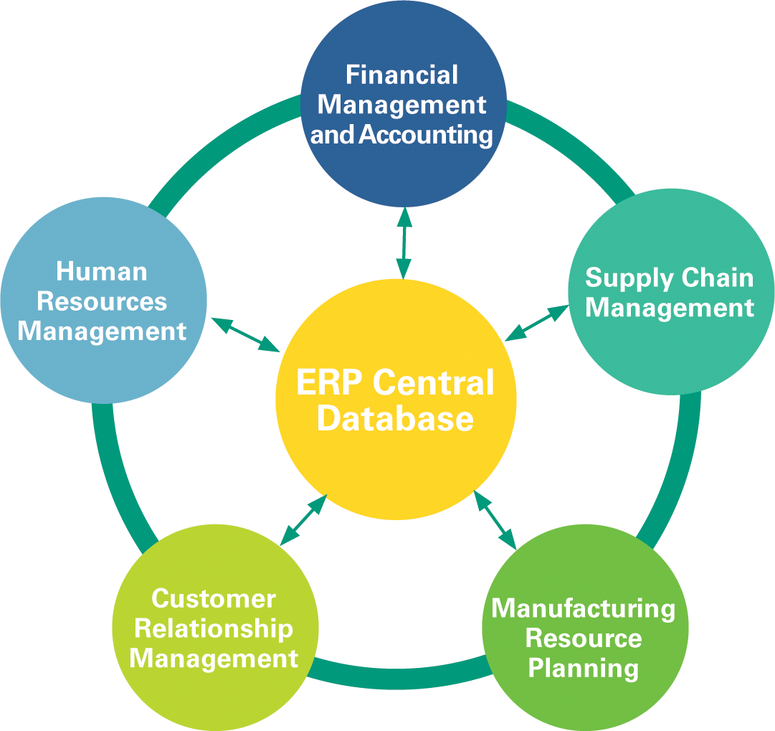
Enterprise Resource Planning (1 of 3)
The acronym ERP stands for enterprise resource planning; it is a suite of software modules that integrate major business activities; it is sometimes described as “the central nervous system of an enterprise”

Slide 32
Enterprise Resource Planning (2 of 3)
An ERP system can provide the following benefits to an enterprise:
Improved overall performance by standardizing business processes based on best practices
Minimized technology overhead for managers and other workers who interact with a single, centralized, and integrated set of software modules
Increased efficiency and productivity from streamlined workflows
Improved access to information from a single database

Slide 33
Enterprise Resource Planning (3 of 3)
Enhanced customer satisfaction based on efficient sales and distribution
Reduced costs and errors when transferring data between systems, such as accounting and human resources
Increased profitability from the ability to collect analytics all aspects of business operations
Reduced inventory costs resulting from better planning, forecasting, modeling, and tracking

Slide 34
Section C: Systems Analysis
System Development Life Cycle
Planning Phase
Analysis Phase
Documentation Tools

Slide 35
Section C: Objectives
List the five phases of the SDLC
List five tasks that are completed during the planning phase
Draw a diagram of Michael Porter’s Five Forces model
Define BI, BPM, JIT, MRP, and TQM
Use PIECES to classify problems and opportunities
Describe the three activities that take place during the analysis phase
Briefly describe at least six tools used by systems analysts

Slide 36
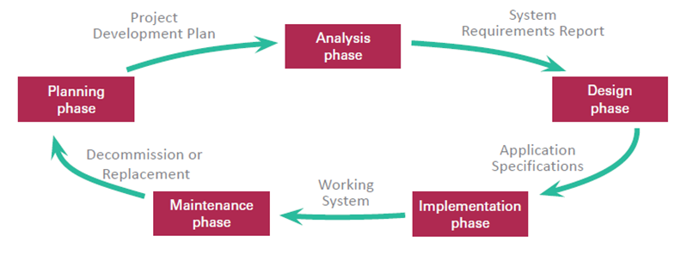
System Development Life Cycle (1 of 2)
An information system progresses through several phases as it is developed, used, and retired; these phases encompass as system development life cycle or SDLC

Slide 37
System Development Life Cycle (2 of 2)
Systems analysis and design is a discipline that focuses on developing information systems according to the phases of an SDLC
The scope of systems analysis and design encompasses the people, procedures, computers, communications networks, and software involved with handling information in an organization

Slide 38
Planning Phase (1 of 10)
The planning phase for an information system project includes:
Assembling the project team
Justifying the project
Choosing a development methodology
Developing a project schedule
Producing a project development plan

Slide 39
Planning Phase (2 of 10)
The goal of these activities is to create a project development plan; this planning document includes:
A short description of the project including its scope
An estimate of the project costs and potential financial benefits
A list of project team participants
A schedule for the project, including an outline of its phases

Slide 40
Planning Phase (3 of 10)
To be successful, an enterprise has a choice of three fundamental responses:
Make improvements
Change the industry
Create new products

Slide 41
Planning Phase (4 of 10)
Project team members can identify problems and opportunities using a variety of techniques, such as interviews and data analysis
The PIECES framework helps classify problems in an information system; each letter of PIECES stands for a potential problem

Slide 42
Planning Phase (5 of 10)
BI (Business Intelligence): An integrated set of technologies and procedures used to collect and analyze data pertaining to sales, production, and other internal operations of a business in order to make better business decisions.
BPM (Business Process Management): A structured methodology for improving business performance by monitoring, measuring, and modifying processes that support the people, systems, and goals in an enterprise.

Slide 43
Planning Phase (6 of 10)
JIT (Just In Time): A manufacturing system in which the parts needed to construct a finished product are produced or arrive at the assembly site just when they are needed. JIT tends to reduce costs by eliminating substantial warehousing expenses and obsolete parts.
MRP (Manufacturing Resource Planning): Calculates and maintains an optimum manufacturing plan based on master production schedules, sales forecasts, inventory status, open orders, and invoices. If properly implemented, it improves cash flow and increases profitability. MRP provides businesses with the ability to

Slide 44
Planning Phase (7 of 10)
be proactive rather than reactive for the management of their inventory levels and material flow.
TQM (Total Quality Management): A technique initiated by top management that involves all employees and all departments, and focuses on quality assurance in every product and service offered to customers.

Slide 45
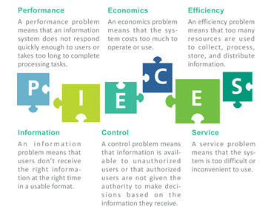
Planning Phase (8 of 10)

Slide 46
Planning Phase (9 of 10)
There are many standard system development methodologies:
Structured methodology focuses on the processes that take place within an information system
Information engineering methodology focuses on the data an information system collects before working out ways to process that data
Object-oriented methodology treats an information system as a collection of objects that interact to accomplish tasks

Slide 47
Planning Phase (10 of 10)
Project management software is an effective tool for planning and scheduling
Industry standard tools for scheduling and project management include:
PERT (Program Evaluation and Review Technique) – used for analyzing the time needed to complete each project task
WBS (work breakdown structure) – breaks a complete task into a series of subtasks
Gantt charts – shows the duration of development tasks as they occur over time

Slide 48
Analysis Phase (1 of 2)
The goal of the analysis phase is to produce a list of requirements for a new or revised information system; tasks for this phase include:
Studying the current system
Determining system requirements
Writing a requirements report

Slide 49
Analysis Phase (2 of 2)
System requirements are the criteria for successfully solving problems identified in an information system
They also serve as an evaluation checklist at the end of a project, so they are sometimes referred to as success factors
System requirements are incorporated into a document called a system requirements report that describes the objectives for the information system

Slide 50
Documentation Tools (1 of 6)
The core documentation tool for project teams using structured methodology is the data flow diagram (DFD), which graphically illustrates how data moves through an information system
In DFD terminology:
An external entity is a person, organization, or device used outside the information system that originates or receives data
A data store is a medium that holds data
A process is a routine that changes data by performing a calculation
An arrow symbolizes a data flow and indicates how data travels

Slide 51
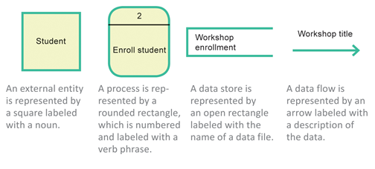
Documentation Tools (2 of 6)

Slide 52
Documentation Tools (3 of 6)
The current standard for object-oriented documentation is referred to as UML (Unified Modeling Language)
Three of the most frequently used UML tools include use case diagrams, sequence diagrams, and class diagrams
A use case diagram documents the users of an information system and the functions they perform
In object-oriented jargon, the people who use the system are called actors; any task an actor performs is called a use case

Slide 53
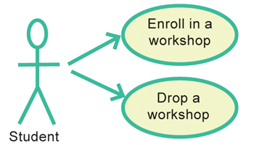
Documentation Tools (4 of 6)
A use case diagram for a workshop registration system depicts two use cases—one in which a student (actor)b enrolls in a workshop (use case 1), and one in which the student drops the workshops (use case 2).

Slide 54
Documentation Tools (5 of 6)
A class diagram provides the name of each object, a list of each object’s attributes, a list of methods, and an indication of the associations between objects
A sequence diagram depicts the detailed sequence of interactions that take place for a use case
A CASE tool (computer-aided software engineering tool) is a software application designed for documenting system requirements, diagramming current and proposed information systems, scheduling development tasks, and developing computer programs

Slide 55
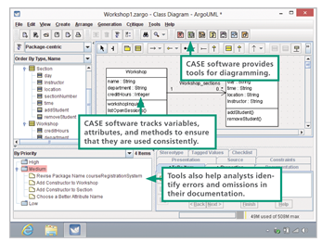
Documentation Tools (6 of 6)

Slide 56
Section D: Design and Implementation
Design Phase
Evaluation and Selection
Application Specifications
Implementation Phase
Documentation and Training
Conversion and Cutover
Maintenance Phase

Slide 57
Section D: Objectives (1 of 2)
List five activities that take place in the design phase of system development
Compare and contrast the four categories of software solutions that are available to the design team
Explain why some projects have a detailed design phase while other projects do not
Describe the significance of feature creep

Slide 58
Section D: Objectives (2 of 2)
List at least five activities that take place in the implementation phase
Describe five types of testing that take place in the implementation phase
Describe four cutover methods
List and describe six QoS metrics

Slide 59
Design Phase (1 of 2)
In the design phase of the SDLC, the project team must figure out how the new system will fulfill the requirements specified in the system requirements report
Activities that take place during the design phase:
Identify potential solutions
Evaluate solutions and select the best one
Select hardware and software
Develop application specifications
Obtain approval

Slide 60
Design Phase (2 of 2)
The project team has to consider the overall architecture based on:
Device requirements
Network technology
Cloud hosting
Level of automation

Slide 61
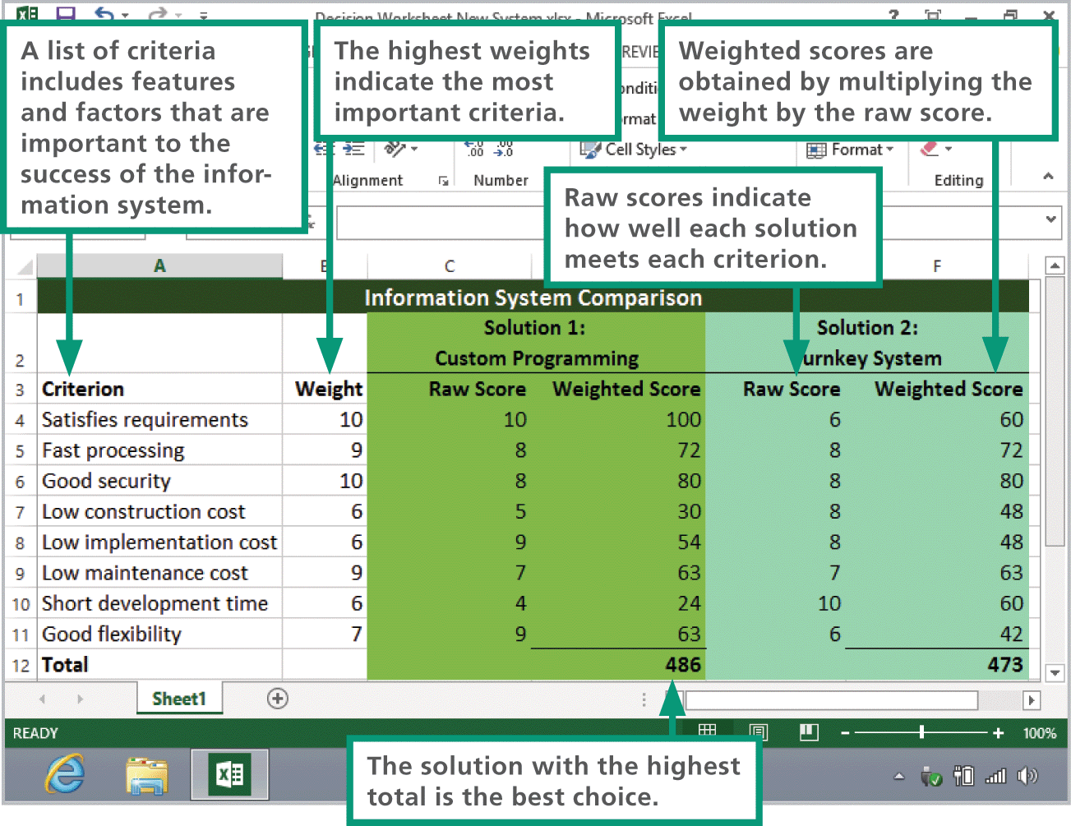
Evaluation and Selection
Using a decision support worksheet, the project team can assign scores to each criterion, weigh them, and compare totals for all solutions

Slide 62
Application Specifications (1 of 2)
The team’s systems analysts will create a set of application specifications that describe the way information system’s software should interact with users, store data, process data, and format reports
The goal of the detailed design phase is to create very detailed specifications for the complete information system

Slide 63
Application Specifications (2 of 2)
Some projects fail because of constant, unmanaged demand for changes, even before the system is implemented. This failure to constrain change is often referred to as feature creep
Proposed changes should be managed within a formal process that includes written change requests, which detail the scope of a proposed change and can be evaluated by project team members

Slide 64
Implementation Phase (1 of 3)
During the implementation phase of the SDLC, the project team supervises the tasks necessary to construct the new information system
Tasks that take place during this phase include:
Purchase or contract for hardware/software
Create applications
Test applications
Finalize documentation
Train users
Convert data
Initiate new system

Slide 65
Implementation Phase (2 of 3)
Software customization is the process of modifying a commercial application to reflect an organization’s needs
Application testing is the process of trying out various sequences of input values and checking the results to verify that the application works as it was designed
As each application module is completed, it undergoes unit testing to ensure that it operates reliably and correctly
When all modules have been completed and tested, integration testing is performed to ensure that the modules operate together correctly
System testing ensures that all the hardware and software components work together

Slide 66
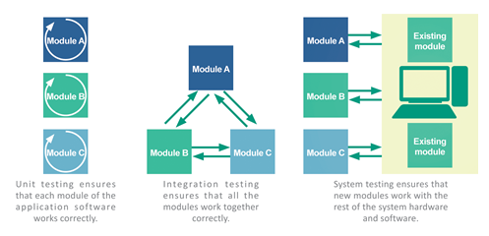
Implementation Phase (3 of 3)

Slide 67
Documentation and Training
System documentation describes a system’s features, hardware architecture, and programming
User documentation describes how to interact with the system to accomplish specific tasks
A procedure handbook is a type of user documentation that contains step-by-step instructions for performing tasks

Slide 68
Conversion and Cutover
System conversion refers to the process of deactivating an old information system and activating a new one; it is also referred to as a “cutover” or “to go live”
Acceptance testing is designed to verify that the new information system works as required

Slide 69
Maintenance Phase (1 of 3)
The maintenance phase of the SDLC involves the day-to-day operation of the system, making modifications to improve performance, and correcting problems
Changes during the maintenance phase can include the following:
Updates to the operating system and application software
User interface revisions to make the system easier to use
Hardware replacements necessary to retire defective equipment or enhance performance
Security upgrades
Quality-of-service enhancements

Slide 70
Maintenance Phase (2 of 3)
The term quality of service (QoS) refers to the level of performance a computer system provides
A quality-of-service metric is a technique used for measuring a specific QoS characteristic
Many organizations establish a help desk to handle end-user problems; it is staffed by technical support specialists

Slide 71
Maintenance Phase (3 of 3)
QOS METRIC | DESCRIPTION
Throughput | Amount of data processed in a particular time interval
Accuracy | Number of errors occurring in a particular time interval for a particular function
Downtime | Amount of time a system is not available for processing
Capacity | Available storage space, number of users, number of connections, or number of packets
User levels | Number of users at peak, average, and low times
Response time | Time period between when a user initiates a request for information and when the request is fulfilled

Slide 72
Section E: System Security
Systems at Risk
Data Centers
Disaster Recovery Planning
Data Breaches
Security Measures

Slide 73
Section E: Objectives
List at least five kinds of disasters that put information systems at risk
Explain three ways that a data center can reduce the risk of disasters that destroy data
Describe the elements of a disaster recovery plan
Name five things that can trigger a data breach
Describe how identity thieves use stolen data
Explain four security measures that protect data from breaches
Describe consumer notification laws in education, health care, and banking
List five steps that data breach victims should follow

Slide 74
Systems at Risk
The kinds of disasters that put information systems at risk include:
Natural disasters
Power outages
Equipment failures
Human errors
Software failures
Acts of war
Security vulnerabilities

Slide 75
Data Centers (1 of 4)
A data center is a specialized facility designed to hold and protect computer systems and data
These centers may be dedicated to information systems for a single company, or they may be a colocation center in which several corporations lease space and equipment
Lights-out management (LOM) allows system administrators to monitor and manage servers using remote control software

Slide 76
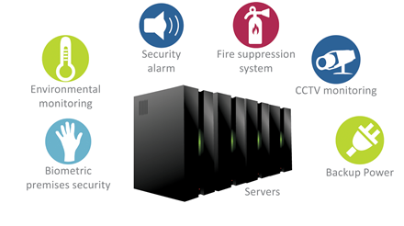
Data Centers (2 of 4)

Slide 77
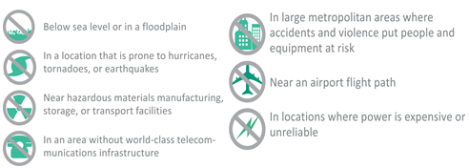
Data Centers (3 of 4)

Slide 78
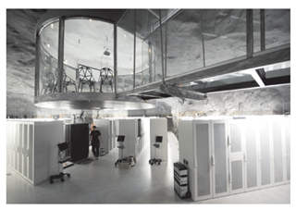
Data Centers (4 of 4)
Bahnhof Pionen is located 100 feet beneath Stockholm, Sweden, and sometimes called the 'James Bond" data center.
Iron Mountain us located 220 feet underground in a limestone cave near Pittsburgh.
Smartbunker runs on wind power and is housed in a former NATO command bunker in the Lincolnshire Welds. U.K.
InfoBunker is a 65,000-square-foot data center built in a decommissioned Air Force bunker designed to survive a 20-megaton nuclear blast

Slide 79
Disaster Recovery Planning
A disaster recovery plan is a step-by-step description of the methods used to secure data against disaster and a set of guidelines for how an organization will recover lost data and resume operations if and when a disaster occurs
Disaster recovery plans should:
Ensure the safety of people on the premises at the time of a disaster Continue critical business operations
Minimize the duration of a serious disruption to operations
Minimize immediate damage and prevent additional losses
Establish management succession and emergency powers
Facilitate effective coordination of recovery tasks

Slide 80
Data Breaches (1 of 2)
A data breach is an incident in which personal data is viewed, accessed, or retrieved without authorization
Data breaches can be caused by the following:
Malware attacks
Employee negligence
Insider theft
Device theft
System glitches

Slide 81
Data Breaches (2 of 2)
Identity theft is the fraudulent use of someone’s personal information to carry out transactions, such as applying for loans, making purchases, collecting tax refunds, or obtaining false identity documents

Slide 82
Security Measures (1 of 4)
Measures that protect information systems can be grouped into four categories: deterrents, preventative countermeasures, corrective procedures, and detection activities
Deterrents reduce the likelihood of a deliberate attack. Physical deterrents, such as limiting access to critical servers, fall under this category. Common deterrents also include security features such as multi-level authentication, password protection, and biometric identification.

Slide 83
Security Measures (2 of 4)
Preventive countermeasures shield vulnerabilities to render an attack unsuccessful or reduce its impact. Firewalls that prevent unauthorized access to a system and encryption that makes stolen data indecipherable are examples of preventive countermeasures.
Corrective procedures reduce the effect of an attack. Data backups, disaster recovery plans, and the availability of redundant hardware devices all are examples of corrective procedures.

Slide 84
Security Measures (3 of 4)
Detection activities recognize attacks and trigger preventive countermeasures or corrective procedures. For example, antivirus software detects viruses entering a system and can be configured to perform corrective procedures such as removing the virus and quarantining infected files. Theft or vandalism can be detected by periodic hardware inventories. The use of monitoring software to track users, file updates, and changes to critical systems can also help detect anomalies that indicate an intrusion or a threat.

Slide 85
Security Measures (4 of 4)
To minimize the risk of identify theft, customers should be vigilant about the information they divulge, for example:
Know when data is being collected
Find out how data is being used
Find out what data is retained
Don’t trade your privacy

